Slide 1
4-2: No need for genius envy – the imposter syndrome
By Barbara Oakley, PhD

Slide 3


Slide 4
10⁴  10⁵ = 10⁹

Slide 5


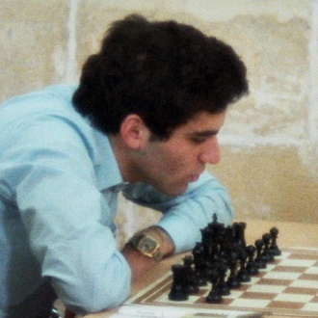

Slide 6
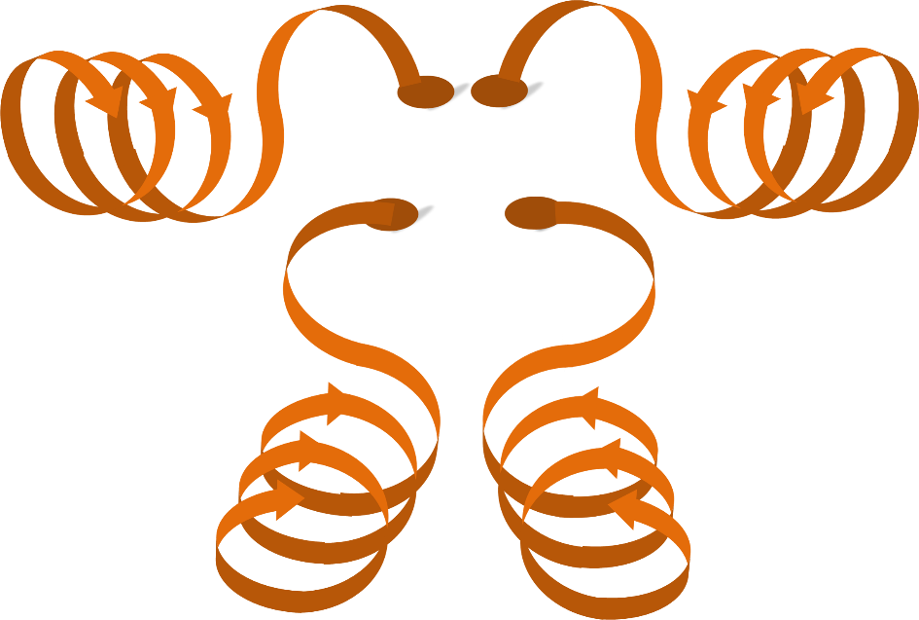

Einstellung

Slide 7
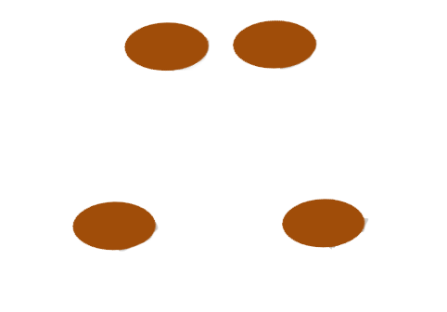




Slide 8
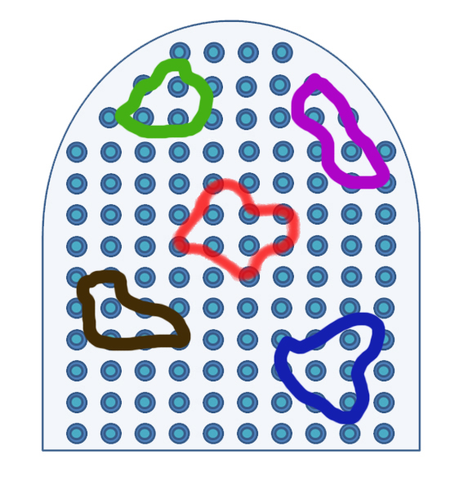
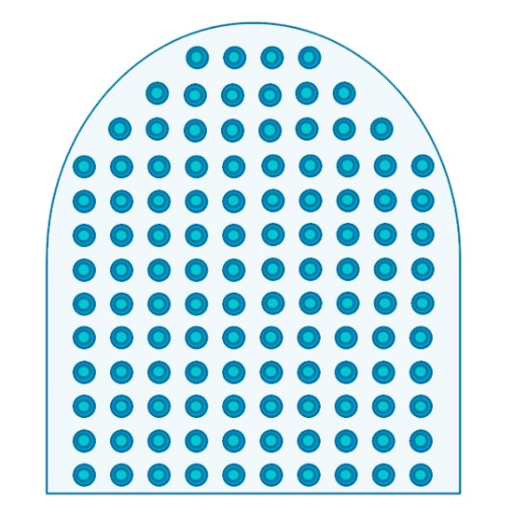
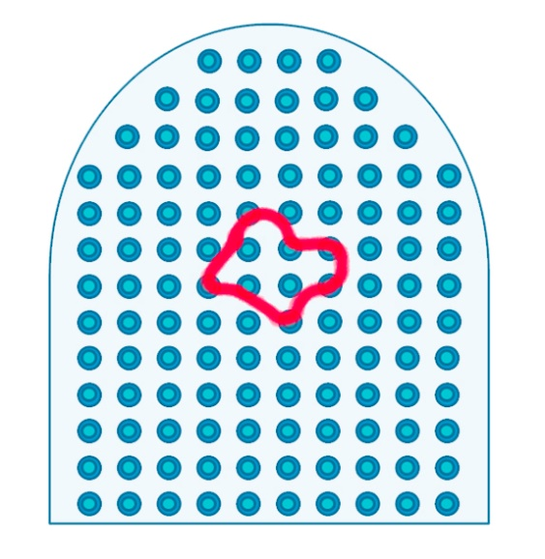

Slide 9


Imposter syndrome

Slide 10
Illustration credits
Zombie baseball player, ©Kevin Mendez, 2014.
Garry Kasparov 1980 Malta, by GFHund,
http://en.wikipedia.org/wiki/Garry_Kasparov#mediaviewer/File:Garry_Kasparov_1980_Malta.jpg
Neural chunked ribbons, ©Barbara Oakley, 2014.
Neural pinball, ©Barbara Oakley, 2014.
Clip art courtesy Microsoft Corporation.

Slide 11
Relevant readings
Amidzic, Ognjen, Hartmut J. Riehle, and Thomas Elbert. "Toward a Psychophysiology of Expertise." Journal of Psychophysiology 20, no. 4 (2006): 253-58.
Beilock, Sian. Choke. NY: Free Press, 2010.
Bilalic, M., P. McLeod, and F. Gobet. "Inflexibility of Experts--Reality or Myth? Quantifying the Einstellung Effect in Chess Masters." [In eng]. Cognitive Psychology 56, no. 2 (Mar 2008): 73-102.
Bilalić, Merim , Robert Langner, Michael Erb, and Wolfgang Grodd. "Mechanisms and Neural Basis of Object and Pattern Recognition: A Study with Chess Experts." Journal of Experimental Psychology: General 139, no. 4 (2010): 728-42.
Bilalić, Merim , P. McLeod, and F. Gobet. "Why Good Thoughts Block Better Ones: The Mechanism of the Pernicious Einstellung (Set) Effect." Cognition 108, no. 3 (Sep 2008): 652-61.
Bilalić, Merim, A. Kiesel, C. Pohl, M. Erb, and W. Grodd. "It Takes Two—Skilled Recognition of Objects Engages Lateral Areas in Both Hemispheres." [In eng]. PLoS ONE 6, no. 1 (2011): e16202.
Bilalić, Merim, Peter McLeod, and Fernand Gobet. "Does Chess Need Intelligence? — a Study with Young Chess Players." Intelligence 35, no. 5 (2007): 457-70.
Carson, Shelley H, Jordan B Peterson, and Daniel M Higgins. "Decreased Latent Inhibition Is Associated with Increased Creative Achievement in High-Functioning Individuals." Journal of Personality and Social Psychology 85, no. 3 (2003): 499-506.
Chase, W.G., and H.A. Simon. "Perception in Chess." Cognitive Psychology 4, no. 1 (1973): 55-81.
Ericsson, Karl Anders. Development of Professional Expertise. NY: Cambridge University Press, 2009.
Felder, R. "Impostors Everywhere." Chemical Engineering Education 22, no. 4 (1988): 168-69.
Gobet, F., and N. Charness, eds. Chess and Games. edited by K. Anders Ercisson, Neil Charness, Paul Feltovich and Robert R. Hoffman, Cambridge Handbook on Expertise and Expert Performance: Cambridge University Press, 2006.
Gobet, F., and G. Clarkson. "Chunks in Expert Memory: Evidence for the Magical Number Four… or Is It Two?". Memory 12, no. 6 (2004): 732-47.
Gobet, F., P.C.R. Lane, S. Croker, P.C.H. Cheng, G. Jones, I. Oliver, and J.M. Pine. "Chunking Mechanisms in Human Learning." Trends in Cognitive Sciences 5, no. 6 (2001): 236-43.
Gobet, Fernand. "Chunking Models of Expertise: Implications for Education." Applied Cognitive Psychology 19, no. 2 (2005): 183-204.
Guida, A., F. Gobet, H. Tardieu, and S. Nicolas. "How Chunks, Long-Term Working Memory and Templates Offer a Cognitive Explanation for Neuroimaging Data on Expertise Acquisition: A Two-Stage Framework." Brain and Cognition 79, no. 3 (Aug 2012): 221-44.
Klein, G. Sources of Power. Cambridge, MA: MIT Press, 1999.
Klein, HA, and GA Klein. "Perceptual/Cognitive Analysis of Proficient Cardio-Pulmonary Resuscitation (Cpr) Performance." Paper presented at the Midwestern Psychological Association Conference, Detroit, MI, 1981.
Linhares, Alexandre, and Anna Elizabeth T. A. Freitas. "Questioning Chase and Simon's (1973) “Perception in Chess”: The “Experience Recognition” Hypothesis." New ideas in psychology 28, no. 1 (2010): 64-78.
Partnoy, F. Wait. NY: PublicAffairs, 2012.
Simon, H.A., and W.G. Chase. "Skill in Chess: Experiments with Chess-Playing Tasks and Computer Simulation of Skilled Performance Throw Light on Some Human Perceptual and Memory Processes." American Scientist 61, no. 4 (1973): 394-403.
White, H.A., and P. Shah. "Uninhibited Imaginations: Creativity in Adults with Attention-Deficit/Hyperactivity Disorder." Personality and Individual Differences 40, no. 6 (2006): 1121-31.
White, Holly A, and Priti Shah. "Creative Style and Achievement in Adults with Attention-Deficit/Hyperactivity Disorder." Personality and Individual Differences 50, no. 5 (2011): 673-77.

